Slide 1
Applied Physics(C. Sc.) BS CS Semester-I Course Code: L-28(Survival in cold and hot climates.) IUB & All Affiliated Colleges. Reality Awards Boost Up (YT-Channel)
Rushmat Ali
Assistant Professor of Physics
Govt. Kh. F. Graduate College R. Y. Khan.

Slide 2
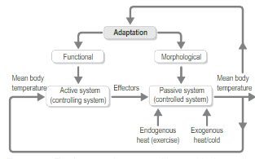
Origin of cold and heat adaptations
Modern humans emerged from Africa approximately 70,000 years ago during a period of unstable climate, leading to a variety of new traits among the population.
Researchers hypothesize that early modern humans were more evolutionarily fit to live in various climate.
Variability selection hypothesis proposed by Richard Potts says that human adaptability came from environmental.
Bergmann's rule states that endothermic animal subspecies living in colder climates have larger bodies than those of the subspecies living in warmer .
Allen's rule is a biological rule says the limbs of endotherms are shorter in cold climates and longer in hot climates. Limb length affects the body's surface area, which helps with thermoregulation. Shorter limbs help to conserve heat, while longer limbs help to dissipate heat.
Marshall T. Newman argues that this can be observed in Eskimo, who have shorter limbs than other people and are laterally built.

Slide 3
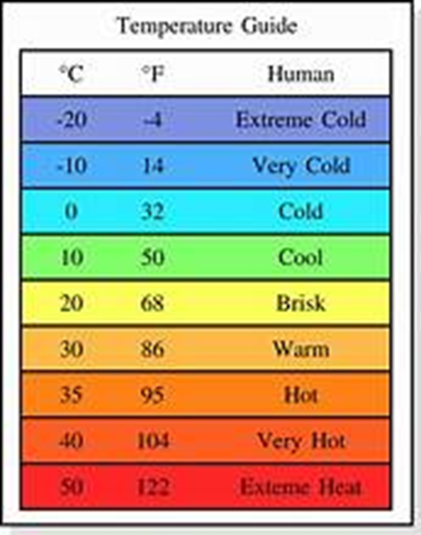
Climatic Adaptation/Thermoregulations:
Physical adaptations in human beings are seen in response to extreme cold, humid heat, desert conditions, and high altitudes.
Cold Adaptation: is of three types:
Adaptation to extreme cold, moderate cold, and night cold.
Extreme cold favours short, round persons with short arms and legs, flat faces with fat pads over the sinuses, narrow noses, and a heavier-than-average layer of body fat. These adaptations provide minimum surface area in relation to body mass for minimum heat loss, minimum heat loss in the extremities (which allows manual dexterity during exposure to cold and guards against frostbite), and protection of the lungs and base of the brain against cold air in the nasal passages.
Moderate cold favours the tall, stockily built individual with moderate body fat and a narrow nose, for similar reasons.
Night cold often part of a desert environment, where inhabitants must be able to withstand hot, dry daytime conditions as well as cold at night, favours increased metabolic activity to warm the body during sleep.

Slide 4
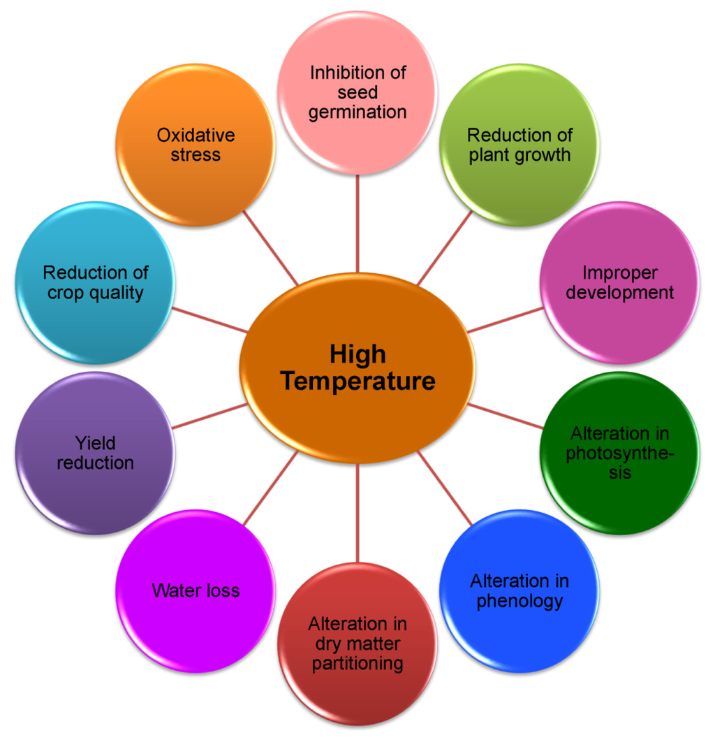
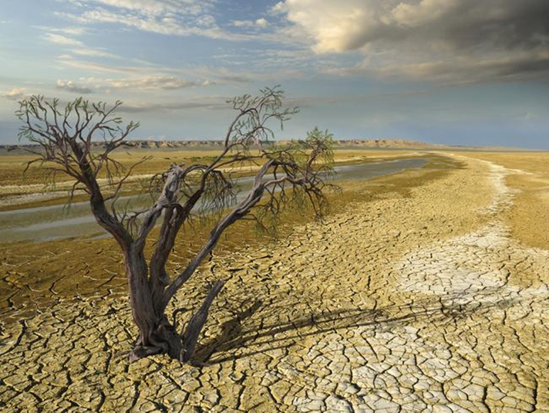
Heat Adaptation:
Heat adaptation is of two types:
Humid Adaptation: Humid heat and dry heat (desert conditions).
Hot climates the problem is not in maintaining body heat but in dissipating it. Normally, the body rids off heat itself by sweating.
In conditions of humid heat, however, the humidity of the surrounding air prevents the evaporation of perspiration to some extent, and overheating may result.
The persons are characteristically tall and thin, often a wide nose, and usually dark skin.
ii. The desert-adapted person can sweat freely but must deal with the water loss involved; usually thin but not tall.
This adaptation minimizes both water needs and water loss.
Skin pigmentation is moderate which is good protection from the sun & allows absorption of heat, lost by sweating. Night cold is also common in desert-adapted people.
High altitudes demand a degree of cold adaptation plus adaptation for low air pressure and the consequent low oxygen. This adaptation is accomplished by an increase in lung tissue generally.

Slide 5
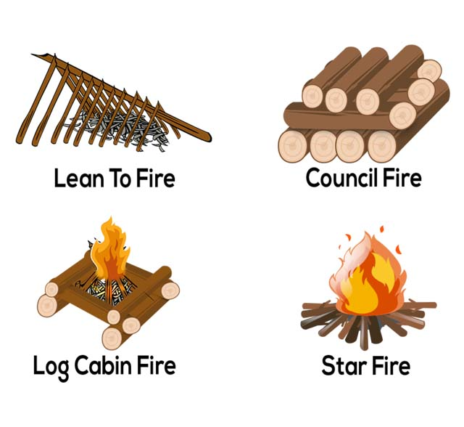
Cold and heat adaptations in humans
Cold and heat adaptations in humans are a part of the broad adaptability of Homo sapiens.
Adaptations in humans can be physiological, genetic, or cultural, which allow people to live in a wide variety of climates.
There is a great research done on developmental adjustment, acclimatization, and cultural practices.
The human body always works to remain in homeostasis. One form of homeostasis is thermoregulation.
Body temperature varies in every individual, but the average internal temperature is 37.0 °C (98.6 °F).
Sufficient stress from extreme external temperature may cause injury or death if it exceeds the ability of the body to thermo-regulate. Hypothermia can set in when the core temperature drops to 35 °C (95 °F).
Hyperthermia can set in when the core body temperature rises above 37.5–38.3 °C (99.5–100.9 °F). Humans have adapted to living in climates where hypothermia and hyperthermia were common primarily through culture and technology: Use of clothing and shelter

Slide 6
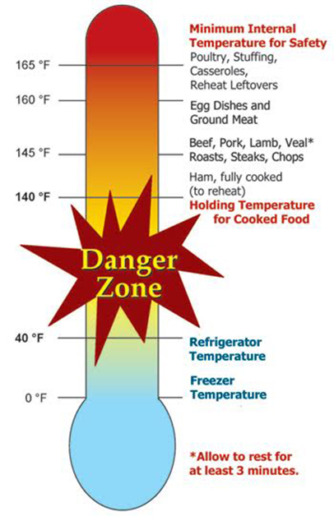
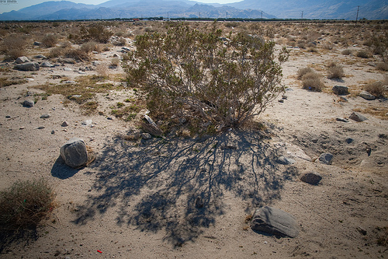
Ecogeographic rules
Bergmann's rule states that endothermic animal subspecies living in colder climates have larger bodies than those of the subspecies living in warmer climates.
Individuals with larger bodies are better suited for colder climates because larger bodies produce more heat due to having more cells, and have a smaller surface area to volume ratio compared to smaller individuals, which reduces heat loss.
A study by Frederick Foster and Mark Collard found that Bergmann's rule can be applied to humans when the latitude and temperature between groups differ widely.
Allen's rule is a biological rule that says the limbs of endotherms are shorter in cold climates and longer in hot climates.
Limb length affects the body's surface area, which helps with thermoregulation. Shorter limbs help to conserve heat, while longer limbs help to dissipate heat.
Marshall T. Newman argues that this can be observed in Eskimo, who have shorter limbs than other people and are laterally built.

Slide 7
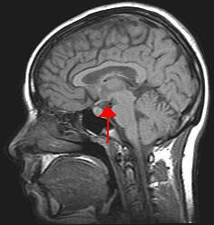
Thermoregulation in Humans
A biological mechanism to maintain steady internal body temperature.
The thermoregulation system includes the hypothalamus, sweat glands, circulatory system, and skin.
The human body maintains a temperature of about 98.6°F (37°C) using various physical processes. These include sweating to lower the body temperature, shivering to raise it, and narrowing or relaxing blood vessels to alter blood flow.
If an individual is unable to regulate their temperature, they could overheat, leading to hyperthermia. The opposite is also true: If the core temperature falls below a safe level, it will cause hypothermia. Both conditions can potentially be life threatening.
Thermoregulation disorders involves sweating, shivering, and narrowing or relaxing blood vessels.
The temperature requiring the least amount of energy investment is 21 °C (69.8 °F). When thermoregulation works, the body performs at its optimum level. A temperature that is too high or too low can affect: Heart, circulatory system, brain, Gastrointestinal tract, Lungs, Kidneys, Liver.
The body controls its temperature through the hypothalamus. Thermo-receptors in the skin send signals to the hypothalamus, which indicate the extreme temperature.
Thermogenesis produces heat to raise the core body temperature. The shivering occurs in an unclothed person when the air temperature is under 25 °C (77 °F). It is limited by the amount of glycogen available in the body. The non-shivering, occurs in brown adipose tissue.

Slide 8
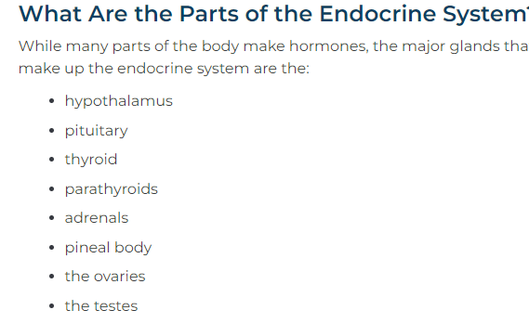
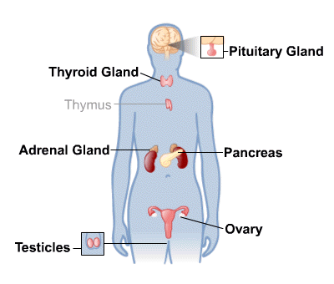
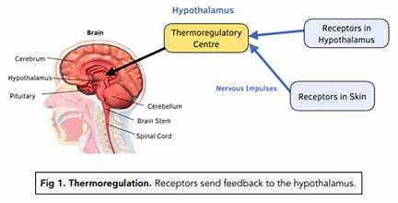
Thermo-regulation Process:
In thermoregulation, body heat is generated mostly in the deep organs, especially the liver, brain, and heart, and in contraction of skeletal muscles.
Humans have been able to adapt to a great diversity of climates. For humans, adaptation to varying climatic conditions includes both physiological mechanisms resulting from evolution and behavioural mechanisms resulting from conscious cultural adaptations.
There are four avenues of heat loss: convection, conduction, radiation, and evaporation. If skin temperature is greater than that of the surroundings, the body can lose heat by radiation and conduction.
If the temperature of the surroundings is greater than that of the skin, the body actually gains heat by radiation and conduction. In such conditions, the only means by which the body can rid itself of heat is by evaporation.
When the surrounding temperature is higher than the skin temperature, anything that prevents adequate evaporation will cause the internal body temperature to rise.
During sports activities, evaporation becomes the main avenue of heat loss. Humidity affects thermoregulation by limiting sweat evaporation and thus heat loss.
Humans cannot survive prolonged exposure to a wet-bulb temperature above 35 °C (95 °F). Such a temperature used to be thought not to occur on Earth's surface but has been recorded in some parts of the Indus Valley and Persian Gulf.
Occurrence of conditions too hot and humid for human life is expected to increase in the future due to global warming.

Slide 9
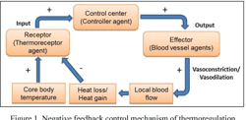
Control system
The core temperature of a human is regulated and stabilized primarily by the hypothalamus, a region of the brain linking the endocrine system to the nervous. As core temperature varies from the set point, endocrine production initiates control mechanisms to increase/decrease energy production/dissipation as needed to return the temperature toward the set point.
In Hot Conditions, Electric fan used in hot weather, Eccrine sweat glands under the skin secrete sweat which travels up the sweat duct, through the sweat pore and onto the surface of the skin.
The hair on the skin lie flat, preventing heat from being trapped by the layer of still air between the hair. When environmental temperature is above core body temperature, sweating is the only physiological way for humans to lose heat.
The smooth muscle walls of the arterioles relax allowing increased blood flow through the artery. This redirects blood into the superficial capillaries in the skin increasing heat loss by convection and conduction.
In Cold Conditions; Heat is lost mainly through the hands and feet, Sweat production is decreased.
The arrector pili muscles (individual hair) contract (pilo-erection), lifting the hair follicle upright. which acts as an insulating layer, trapping heat.
Arterioles carrying blood to superficial capillaries under the surface of the skin can shrink, thereby rerouting blood away from the skin and towards the warmer core of the body.
Hypothalamus cause shivering. It is more effective than exercise at producing heat. There are two types of shivering: low-intensity and high-intensity.

Slide 10
Mechanism The mechanism of thermoregulation involves afferent sensing, central control, and efferent responses. Peripheral and central thermo-receptors sense an increase or decrease in body temperature and send this information to the hypothalamus. The body then responds with multiple mechanisms to either dissipate or generate heat based on the body's needs. The physiological and behavioral responses to the activation of thermo-receptors are as follows.
Increased Body Temperature
The body responds by dissipating heat via:
Activating sympathetic cholinergic fibers innervating sweat glands, leading to increased sweat and increased heat loss
Inhibiting sympathetic activity in blood vessels of the skin, causing blood to be shunted to the skin and an increased heat loss
Decreasing the release of catecho-lamines from the adrenal glands and thyroid hormones from the hypothalamus, leading to a reduced metabolic rate
Behavioral changes include reducing movements, adopting an open body position, removing clothing, and reducing appetite
Factors that can raise your internal temperature include: fever, exercise
digestion
Decreased Body Temperature
The body responds by generating heat via:
Activating the sympathetic nervous system which causes vasoconstriction of skin arterioles, causing blood to bypass the skin and leading to a decreased loss of heat. Adrenal glands will release catecho-lamines leading to increased metabolic rate and heat production.
Releasing thyroid hormones from the hypothalamus causes an increased metabolic rate and subsequent heat production.
Activating the primary motor center in the posterior hypothalamus causes skeletal muscle contraction and shivering.
Non-shivering thermogenesis using brown adipose tissue (BAT) in the first six months of life.
Behavioral changes include increased movements, adopting a closed body position, adding clothing, and an increased appetite.
Factors that can lower your internal temperature include:, drug use
alcohol use, metabolic conditions, under-functioning thyroid gland

Slide 11
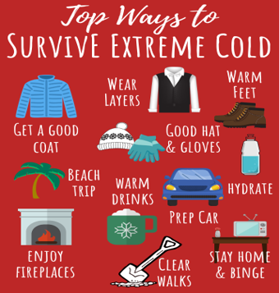
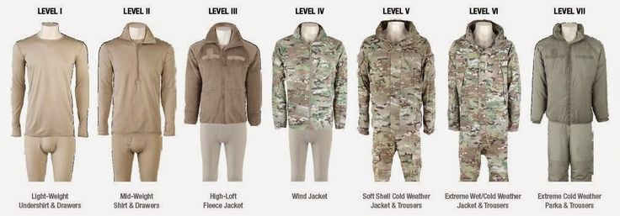
Culture
Social adaptations enabled early modern humans to occupy environments with temperatures that were drastically different from that of Africa. Culture enabled humans to expand their range to areas that would otherwise be uninhabitable.
Cold: Humans have been able to occupy areas of extreme cold through clothing, buildings, and manipulation of fire. Furnaces have further enabled the occupation of cold environments.[16][17]
Historically many Indigenous Australians wore only genital coverings. Studies have shown that the warmth from the fires they build is enough to keep the body from fighting heat loss through shivering. Inuit use well-insulated houses that are designed to transfer heat from an energy source to the living area, which means that the average indoor temperature for coastal Inuit is 10 to 20 °C (50-68 °F).
Heat: Humans inhabit hot climates, both dry and humid, and have done so for millions of years. Selective use of clothing and technological inventions such as air conditioning allows humans to thrive in hot climates.
One example is the Chaamba, who live in the Sahara Desert. They wear clothing that traps air in between skin and the clothes, preventing the high ambient air temperature from reaching the skin.

Slide 12
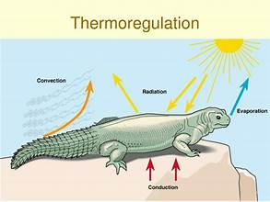
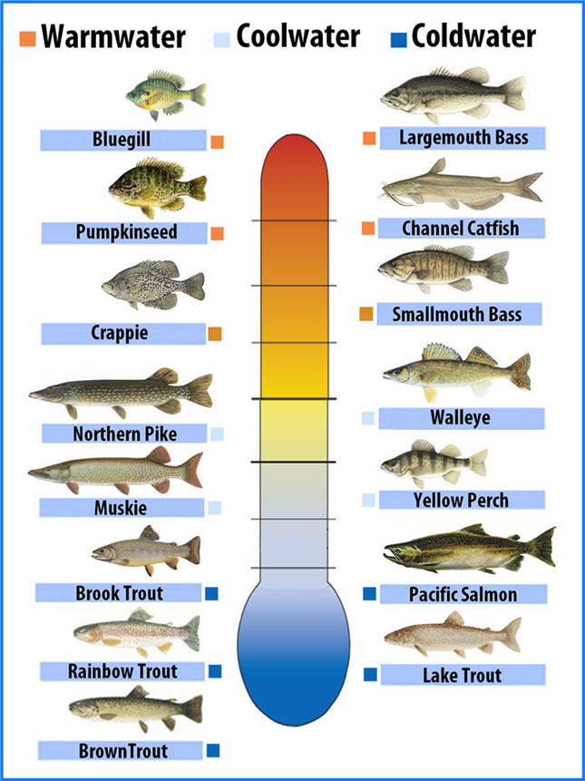
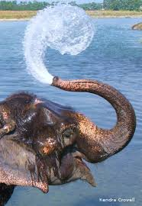
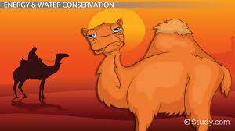
Animal Survival in Extreme Temperatures
Whether special fur, blubber, or unique feet - the ability to adapt gives many wild animals an edge and the ability to withstand extreme temperatures. Insulation matters! In colder regions, many animals have modified fur that helps insulate them from the cold and camouflages them in the snow.
Animals have some amazing adaptations that help them live in even the most hostile environments.
Consider camels, for instance. They can thrive in some of the hottest and driest places on Earth. Their legs don’t get burned when they kneel on hot sand due to thick leathery patches on their knees.
They can survive for an entire week without water but, at the same time, they can drink 32 gallons of water at once. Their body temperature ranges from 93 °F to 107 °F, so they don’t need to sweat very often and can conserve water this way.
The spongy bones in their noses absorb any excess moisture to keep every drop of water in, so the air they breathe out is dry air.
In addition to camels, other animals’ adaptations are equally remarkable. How do they do it?

Slide 13
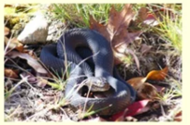

Warm-Blooded or Cold-Blooded?
Warm-blooded animals need to maintain a relatively constant body temperature.
The accepted average body temperature is 98.6 °F for humans. Most other mammals range from 97 °F to 103 °F, Birds have an average body temperature of 105 °F.
The size and shape of an organism is large e.g. animals like elephants, whales, and walruses.
Their large volume rely on the outside environment to heat them and have slow their response times.
The metabolism of food within the body is often referred to as internal combustion.
Animals that don’t migrate, they survive the winter sleep(Hibernation). During hibernation, body temperature drops, breathing and heart rate slows, and most of the body’s metabolic functions are put on hold.
The warm-blooded animal becomes cold-blooded in hibernation, But they are still alive. and they live off their fat reserves. They can store a great body fat, such as bears, groundhogs, and chipmunks.
Smaller warm-blooded animals lose heat more quickly, they will lose heat faster than they can produce it.
Cold-blooded animals do not maintain a constant body temperature.
They get their heat from the outside environment, so their body temperature fluctuates, based on external temperatures. If it is 50 °F outside, their body temperature will eventually drop to 50 °F.
Most of the rest of the animal kingdom—except birds and mammals are cold-blooded.
These animals require less energy to survive than warm-blooded animals do, because much of the energy that drives their metabolism comes from their surroundings.
Reptiles, such as the python, can go a year without eating, &can afford to eat little.
There is a certain temperature below which their metabolism just won’t work.
Cold-blooded animals hibernate, too. But they need to store less fat.
Turtles and frogs bury themselves in mud under lakes and ponds for up to six months at a time, they appear dead. There are no external signs of life.
In hibernation, The fluid around the cells, but not in the cells, is frozen solid. As water freezes outside the cell, water from within the cell is drawn out through osmosis.

Slide 14
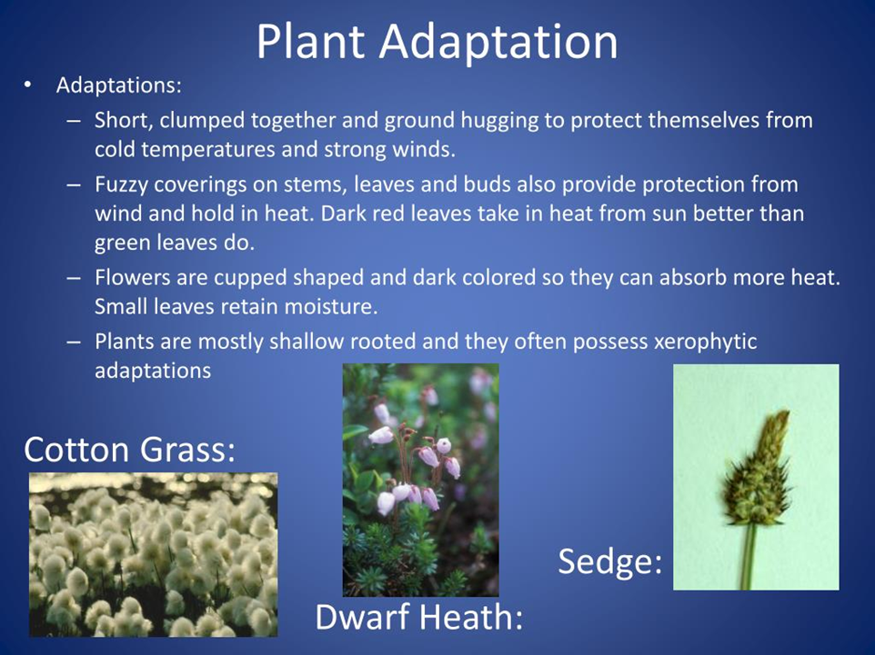
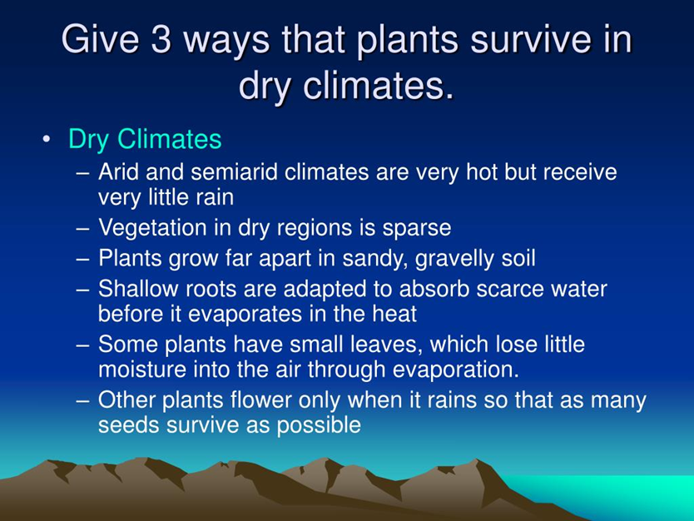
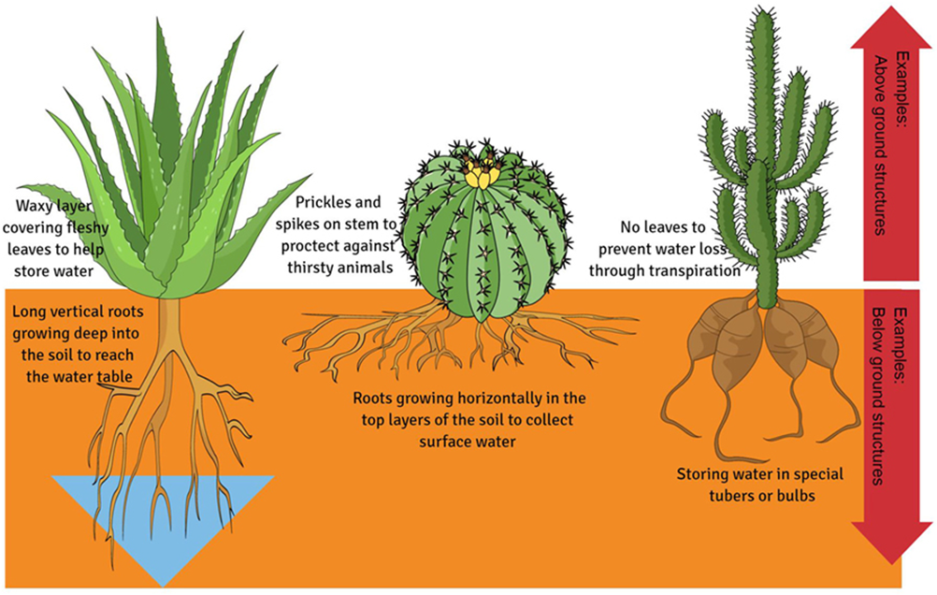
Extreme temperature Adaptations in birds:
The End

